Slide 1

Storage Technologies
Telerik Software Academy
academy.telerik.com
File Systems - Inside FAT and NTFS
Borislav Varadinov
Marian Marinov
System Administrator
CEO of 1H Ltd.
bobi@itp.bg
mm@1h.com

Slide 2


Table of Contents
What is a File System?
What is a File?
What is a Directory?
What is a Cluster?
Overview of File Allocation Table (FAT)
Overview of New Technology File System (NTFS)
NTFS Advanced Features

Slide 3


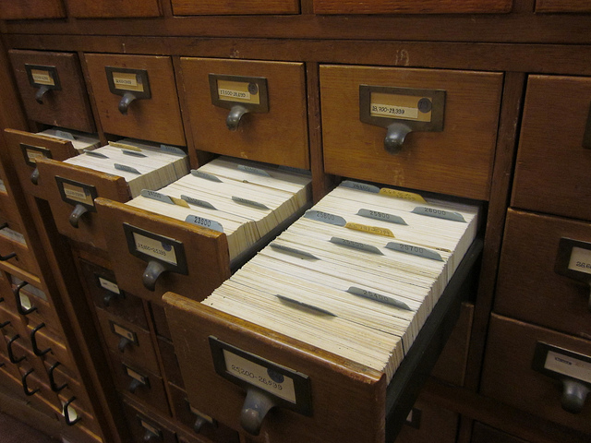
Data Organization

Slide 4
What is a File System?
A file system is
A required part of the operating system
Determines how files are named, stored, and organized on a volume
Manages files and folders, and the information needed to locate and access these items

Slide 5
What is a File?
A file is a logical grouping of related data, identified by a filename
It can be a document, audio, picture, video, application or other

Slide 6
What is a Directory?
A directory is a hierarchical collection of files and other directories
Root Directory:
D:\
D:\Music
D:\Docs
File1.mp3
File2.flac
File1.txt
File2.doc

Slide 7
What is a cluster?
A File System cluster is a unit of disk space allocation for files and directories
To reduce the overhead of managing on-disk data structures, the file system does not allocate individual disk sectors by default, but contiguous groups of sectors, called clusters
A cluster is the smallest logical amount of disk space that can be allocated to hold a file
Storing small files on a filesystem with large clusters will therefore waste disk space; such wasted disk space is called slack space

Slide 8
FAT File System
File Allocation Table (FAT) is a file system developed by Microsoft for MS-DOS and was the primary file system for all consumer versions of Microsoft Windows up to and including Windows Me.
FAT is a simple legacy file system
It offers good performance, but cannot deliver the same performance, reliability and scalability as some modern file systems.
It is however supported for compatibility
Notes:
The FAT file system is a legacy file system which is simple and robust. It offers good performance even in light-weight implementations, but cannot deliver the same performance, reliability and scalability as some modern file systems. It is however supported for compatibility reasons by virtually all existing operating systems for personal computers, and thus is a well-suited format for data exchange between computers and devices of almost any type and age from the early 1980s up to the present.

Slide 9
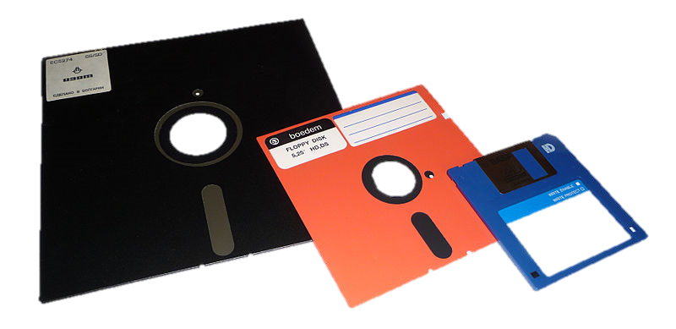
FAT File System (2)
Technically, the term "FAT file system" refers to all three major variants of the file system
FAT8
FAT12
FAT16
FAT32
The numbers (8,12,16,32) refer to the number of bits available to define clusters
Notes:
The FAT file system is a simple file system originally designed for small disks and simple folder structures. The FAT file system is named for its method of organization, the file allocation table, which resides at the beginning of the volume. To protect the volume, two copies of the table are kept, in case one becomes damaged. In addition, the file allocation tables and the root folder must be stored in a fixed location so that the files needed to start the system can be correctly located.

Slide 10
FAT4
FAT 4 – There is no such file system ☺ Just an example
0000 = 0
0001 = 1
0010 = 2
0011 = 3
0100 = 4
0101 = 5
0110 = 6
0111 = 7
1000 = 8
1001 = 9
1010 = 10
1011 = 11
1100 = 12
1101 = 13
1110 = 14
1111 = 15
FAT 12 = 2048+1024+512+256+128+64+32+16+8+4+2+1
0-4095

Slide 11
FAT Volume Organization
A volume's data area is divided up into identically sized clusters
Cluster sizes vary depending on the type of FAT file system being used and the size of the partition
Each file may occupy one or more of these clusters depending on its size
There is no organization to the FAT structure, and files are given the first available location on the volume!!! → fragmentation

Slide 12
What is a File Allocation Table?
The File Allocation Table (FAT) represents a list of entries that map to each cluster on the volume. It tracks the fragmentation of the file.
Each FAT entry records can be:
A pointer (cluster number) to the next cluster
An end of file marker
A special entry to mark a bad cluster
A zero to note that the cluster is unused

Slide 13
What is a Directory Entry?
Directory entries
Track file name, metadata and starting extent of a file
File Metadata (in FAT):
Starting location
Size of the file
DOS type attributes (8 bits)

Slide 14
Structure of FAT Volume
Partition Boot Sector
FAT1
FAT2 (duplicate)
Root
Folder
Other folders and all files

Slide 15
FAT – Read File
1
2
3
Directory
4
5
6
7
Hello.c
6
7
8
8
EOF
9
10
11
12
1
2
3
4
5
6
7
8
9
10

Slide 16
FAT – Create New File
Fragmentation!!!
1
2
EOF
3
4
Directory
4
5
5
9
6
7
Hello.c
6
7
8
Hello.exe
3
8
EOF
9
2
10
11
12
1
2
3
4
5
6
7
8
9
10

Slide 17
Fat32 Advantages and Disadvantages
Advantages
Simple file system
Supported by many computer operating systems
Supported by portable and embedded devices such as phones and tablets.
Disadvantages
High Fragmentation
Missing Security Model
Slow performance
Max file size (One byte less than 4 GB)
Partitions and drives up to 2 terabytes

Slide 18
extFAT (Extended File Allocation Table )
extFAT is a Microsoft proprietary file system optimized for flash drives and multimedia devices.
Introduced in Vista SP1
Significant improvement in volume and file size limitations
Uses free space bitmaps to reduce fragmentation and free space allocation/detection issues.
There is no official specification and the most findings are based on reverse engineering
Windows XP drivers are available by Microsoft
What about Linux/BSD/OSX/…???
Notes:
A FUSE-based implementation named fuse-exfat with read/write support is available for multiple Linux distributions. None of the solutions can become an official part of Linux due to the patent encumbered status of the exFAT filesystem.

Slide 19
New Technology File System (NTFS)
New Technology File System (NTFS) is a proprietary file system developed by Microsoft for Windows NT and all successors to date.
Preferred file system for all Windows (Based on NT)
Provides a combination of performance and reliability not found in the FAT file system
Includes many features required in corporate environment

Slide 20
NTFS Structure
Partition Boot Sector
Master File table
File System
Data
MFT Copy

Slide 21
NTFS Boot Sector
When you format an NTFS volume, the format program allocates the first 16 sectors for the $Boot metadata file
First sector, in fact, is a boot sector with a "bootstrap" code and the following 15 sectors are the boot sector's IPL (initial program loader).
To increase file system reliability the very last sector an NTFS partition contains a spare copy of the boot sector.

Slide 22
NTFS Master File Table (MFT)
Each file on an NTFS volume is represented by a record in a special file called the master file table (MFT)
The MFT is not located in a predefined sector, as on FAT volumes.
The MFT can be moved if there is a bad sector in its normal location
The first 16 records of the table are reserved for special file system information.

Slide 23
NTFS Structure
NTFS is designed as a database. Microsoft's documentation says, "The MFT is a relational database that consists of rows of file records and columns of file attributes. It contains at least one entry for every file on an NTFS volume, including the MFT itself."
Everything in NTFS is a file
The MFT is a file
The boot sector is a file
Directory entries are files that contain a list of other files

Slide 24
Master File Table
Partition Boot Sector
File System
Data
MFT Copy
Master File Table
MFT Ent
Boot Ent

Slide 25
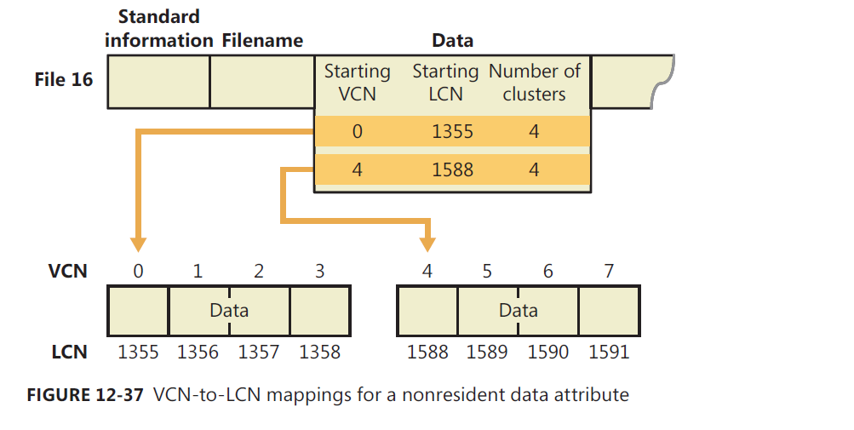
MFT Attributes
Resident Attributes
Non-Resident Attributes
Notes:
Resident Attributes: Attributes that require a relatively small amount of storage space are stored directly within the file's primary MFT record itself. These are called resident attributes. Many of the simplest and most common file attributes are stored resident in the MFT file. In fact, some are required by NTFS to be resident in the MFT record for proper operation. For example, the name of the file, and its creation, modification and access date/time-stamps are resident for every file.
Non-Resident Attributes: If an attribute requires more space than is available within the MFT record, it is not stored in that record, obviously. Instead, the attribute is placed in a separate location. A pointer is placed within the MFT that leads to the location of the attribute. This is called non-resident attribute storage.
In practice, only the smallest attributes can fit into MFT records, since the records are rather small. Many other attributes will be stored non-resident, especially the data of the file, which is also an attribute. Non-resident storage can itself take two forms. If the attribute doesn't fit in the MFT but pointers to the data do fit, then the data is placed in a data run, also called an extent, outside the MFT, and a pointer to the run is placed in the file's MFT record. In fact, an attribute can be stored in many different runs, each with a separate pointer. If the file has so many extents that even the pointers to them won't fit, the entire data attribute may be moved to an external attribute in a separate MFT record entry, or even multiple external attributes.

Slide 26
NTFS Metafiles
NTFS contains several metadata files that define and organize the file system
Filename | Description
$Boot | Contains bootstrap code and a BIOS parameter block including a volume serial number and cluster numbers of $MFT and $MFTMirr.
$MFTMirr | Duplicate of the first vital entries of $MFT, usually 4 entries (4 Kilobytes).
$LogFile | Used to record all disk operations that affect the NTFS volume structure such as file creations, file copying, file deletion, etc. After a system
$Volume | Contains information about the volume ( e.g. file system version and volume label)
$Bitmap | An array of bit entries - each bit indicates whether its corresponding cluster is used (allocated) or free (available for allocation).
$Secure | Stores security information for each object on the file systems objects
$BedClus | A file that contains all the clusters marked as having bad sectors.
Notes:
Ref: http://technet.microsoft.com/en-us/library/cc781134(v=ws.10).aspx

Slide 27
NTFS Features
NTFS Log
USN Journal
Hard links
Symbolic Links (Soft Links) and junction points
Volume mount points
Alternate data streams
File compression
Encrypting File System (EFS)
Quotas
Permissions
Notes:
Alternate data streams - An NTFS file has one default data stream, which has no name. An application can create additional,
named data streams and access them by referring to their names.

Slide 28
Hard Links
A hard link allows multiple paths and filenames to refer to the same on-disk file
A hard link cat exists only within the same volume
Hard link uses the same MFT entry as the original file. Adding a hard link creates a new name attribute
File 1
File Data
File 2
Notes:
Hard link uses the same MFT entry as the original file. Adding a hard link creates a new name attribute and increases the hard link count.
A directory entry contains the name of the file and a copy of the file's standard information attribute (time stamp information).

Slide 29
Junction Points
Junction points refers only to directories
Can link directories located on different local volumes on the same computer
File1
File2
Directory1
File3
File4
Directory2

Slide 30
Symbolic Link
Introduced in Windows Vista
Symbolic Links are files that contains a reference to another file or directory
Can refer to locations on any storage device, including ones on a different local volume or even a share on a different system
File 1
File Data
File 2

Slide 31
Managing Hard and Soft Links
MKLINK [[/D] | [/H] | [/J]] Link Target
/D Creates a directory symbolic link. Default is a file symbolic link.
/H Creates a hard link instead of a symbolic link.
/J Creates a Directory Junction.
Link specifies the new symbolic link name.
Target specifies the path (relative or absolute) that the new link refers to.

Slide 32
Volume Mount Point
Volume mount points enables you to mount volumes as folders
HardDisk:1:Partition:1:
C:\
HardDisk:3:Partition:2:
C:\Program Files
C:\Temp
Microsoft Office
Microsoft SQL Server
TempData1
TmpLogs

Slide 33
NTFS File Compression
NTFS provides built-in file compression on an individual file basis.
Read–Write access to compressed files is transparent
Windows Explorer shows compressed files in blue
Compression is not recommended by Microsoft for files exceeding 30 MB
Compression is not recommended for storage-intensive applications and services
Compressing files that are already compressed may make them bigger as well as slower

Slide 34
Encrypted File System (EFS)
EFS is a built-in file encryption technology integrated with NTFS
Enables transparent file encryption and decryption
Encryption occurs on file level
Encrypted files are protected by the user’s password
Windows Explorer shows encrypted files in green
Available only in business editions

Slide 35
Volume Quotas
NTFS Quotas track and control disk space usage and allowing administrators to control the amount of data that each user can store on a specific volume
Supports per user quota management
Tracks a user’s volume usage relying on the file ownership
Provides Hard and Soft quota limits
Supports logging when a user exceeds a specific space (warning threshold)
Cannot be set on individual files and folders
By using File Server Resource Manager (FSRM), administrators can place also quota limitations on folders

Slide 36
NTFS Permissions
NTFS permissions are used to control the access level that a user or group has to files and directories
Based on the standard NT Security Model
Requirement for multi user environment
Will be discussed further in the next course

Slide 37
NTFS Recovery
CHKDSK

Slide 38
Interoperability
Linux
OS X
BSD
Other

Slide 39
Windows File Systems
http://academy.telerik.com

Slide 40




Free Trainings @ Telerik Academy
"Web Design with HTML 5, CSS 3 and JavaScript" course @ Telerik Academy
html5course.telerik.com
Telerik Software Academy
academy.telerik.com
Telerik Academy @ Facebook
facebook.com/TelerikAcademy
Telerik Software Academy Forums
forums.academy.telerik.com

